Slide 1

Sampling
Dr Alveen Singh
Department of Information Technology
Research skills
Advanced Diploma in ICT
Semester 1 2022

Slide 2
Content
The need for sampling
Probability sampling
Non-probability sampling

Slide 3
Introduction
Sampling ensures that data is collected from the right set of participants
  Sampling allows for generalization of research findings

Slide 4
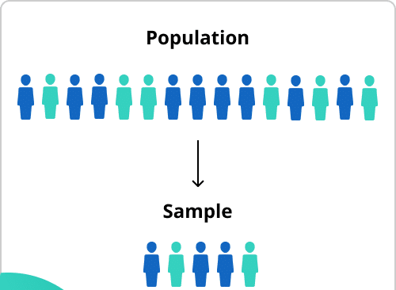
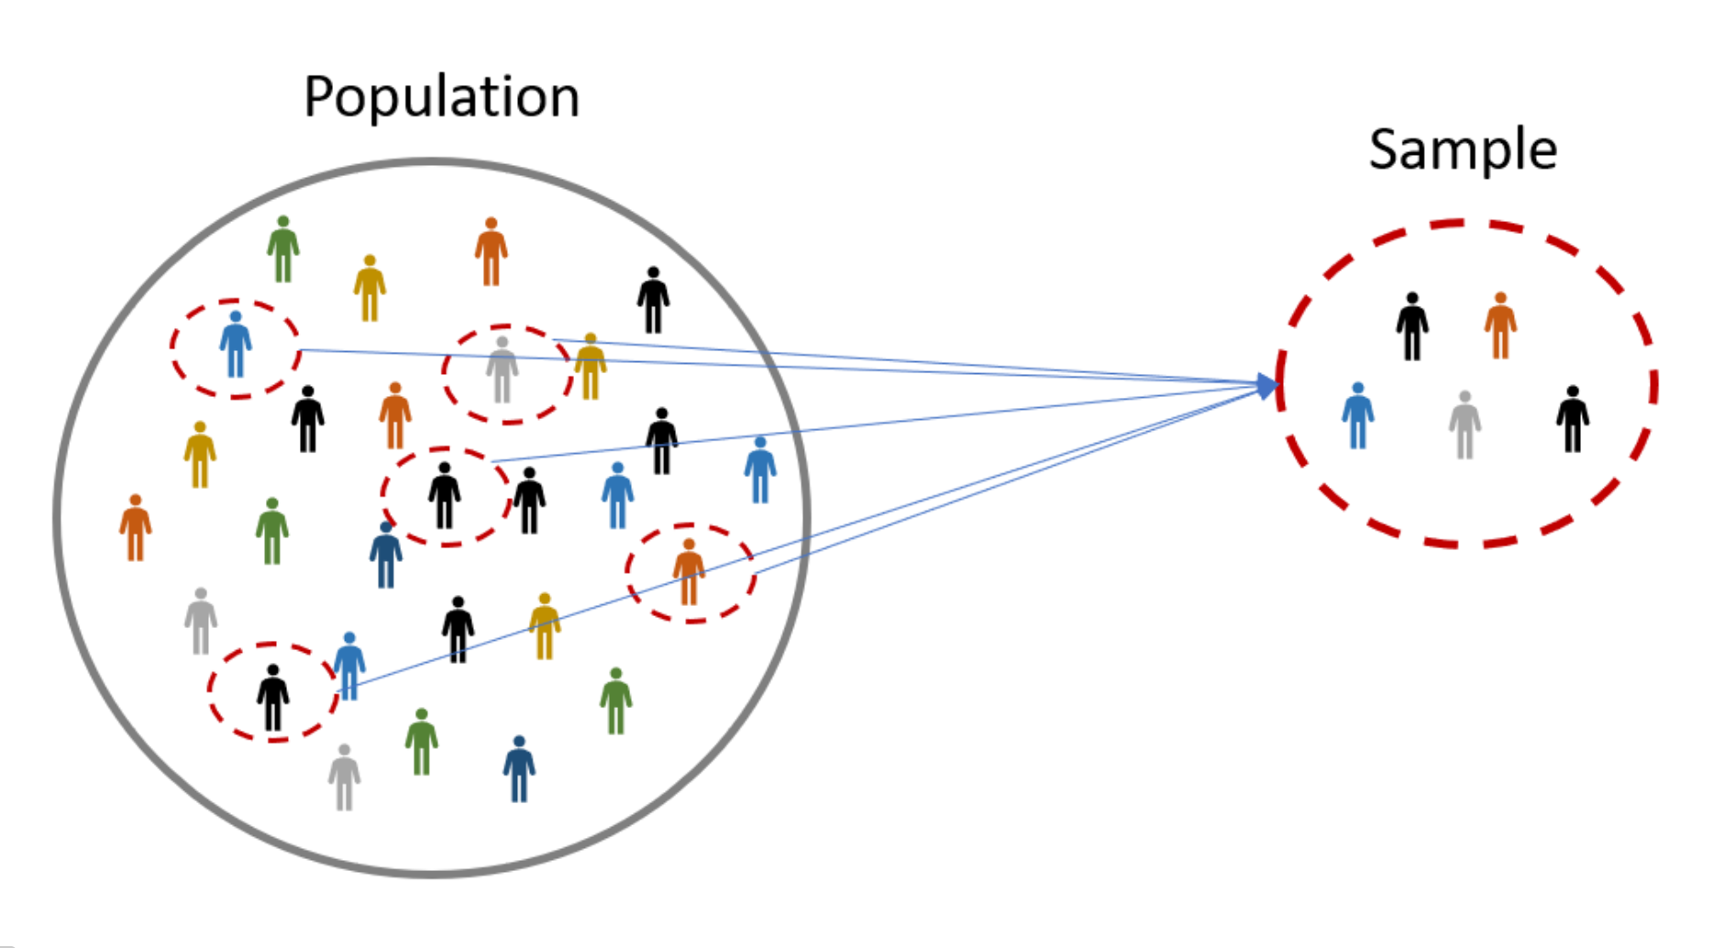
Sampling is the process of selecting some elements in a larger population.
A sample is a smaller group which is a representation of the population.
The purpose is to gather data from the sample that can undergo analysis to produce meaningful conclusions about the population.
Scribbr
Omniconvert, 2020

Slide 5


Depending on the type of research,
Survey – an accurate account of the population is involved in the study
  Allows for generalizability
Qualitative study – a few experts are selected to allow for rich data collection

Slide 6
1. The need for sampling
High cost of using the entire population
Long time frame to collect data might render IT research obsolete by then the results become available
The exact number of the population might not be known hence, probabilities and statics may be flawed

Slide 7
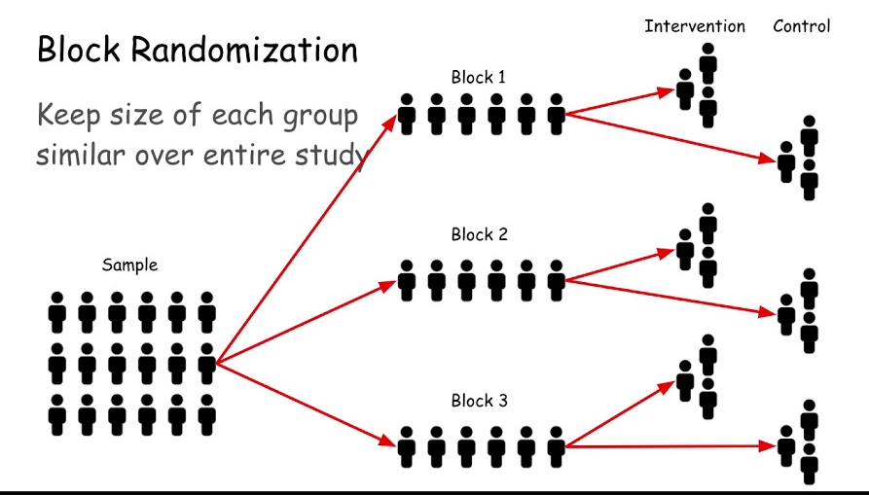
There are two major types of sampling techniques, probability sampling and non-probability sampling.
The difference between the two is the ability for randomization.
Simpson, 2021

Slide 8
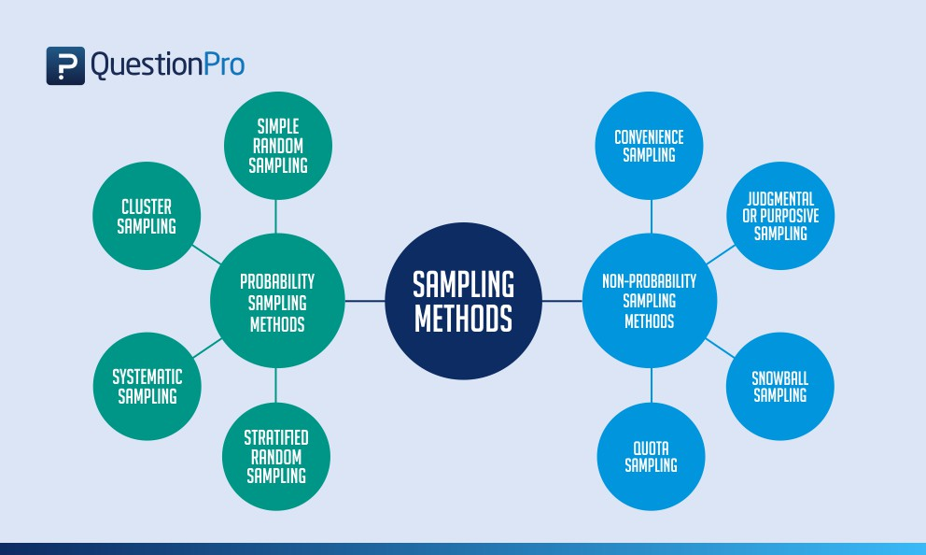
Every member of the population has an equal chance of being selected
The researcher selects the sample
QuestionPro

Slide 9
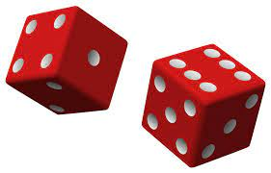
Probability sampling
Every member of the population has an equal chance of being selected

Slide 10
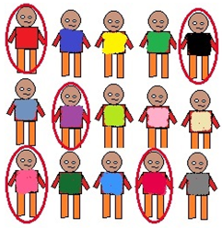
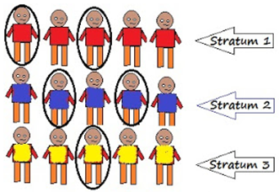
Simple random sampling. 5 out of the 25 in the population are randomly selected giving a probability of selection of 1/25. Every element has an equal opportunity of being selected.
  Stratified sampling. The population is split into groups. Elements are then randomly selected from each group.
Singh, 2018

Slide 11
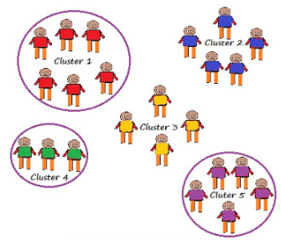
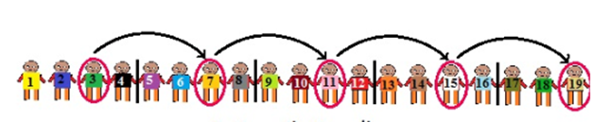
Cluster sampling. The population is split into groups. The researcher selects groups at random. Every element from the selected groups form the sample.
Cluster sampling is useful when each group is representative of the population. For example, there are 34 academic departments at a university and every academic staff member utilize the same ERP for course management. The researcher may randomly choose 5 from the 34 academic departments but include every academic staff member in each of the 5 Departments.
  Systematic random sampling
The population is ordered into a list. A starting point is selected at random and then every nth element is chosen for the sample.
Singh, 2018

Slide 12

Non-probability sampling
No randomization

Slide 13
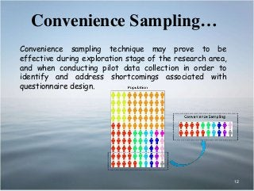
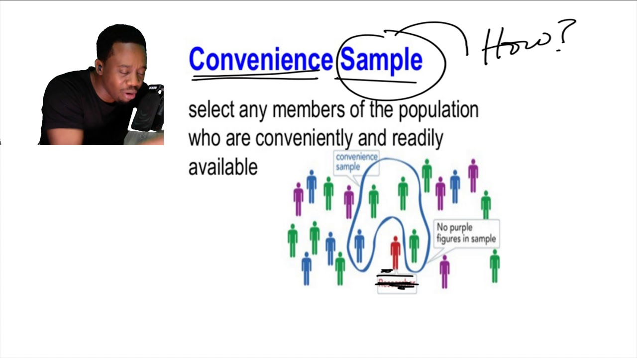
Convenience sampling
Available and willing participants are selected
The research does not require any special criteria of the participant
E.g. questionnaires are handed out to the first 500 IT student that volunteer
99Masterclass, Youtube
Ahmad and Shahzad
99Masterclass - Youtube

Slide 14
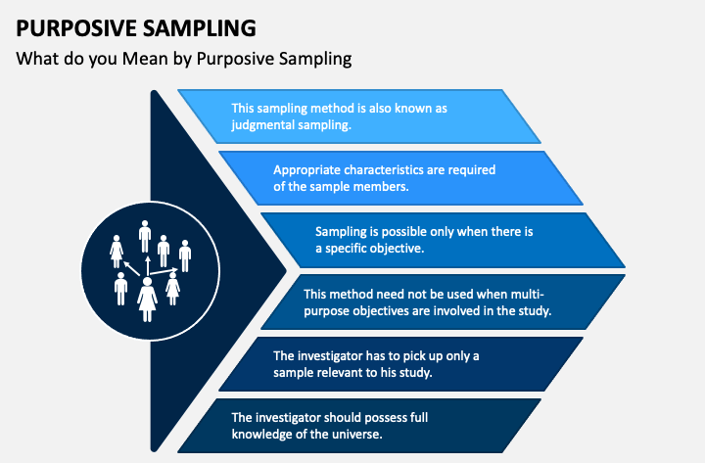
Purposive sampling
When there is a very specific set of characteristics for the sample
Participants are head-hunted
Eg.
Experts in Health Information Systems
Greenhouse farmers
Agile software devs
Online teaching assistants
Sketchbubble.com

Slide 15
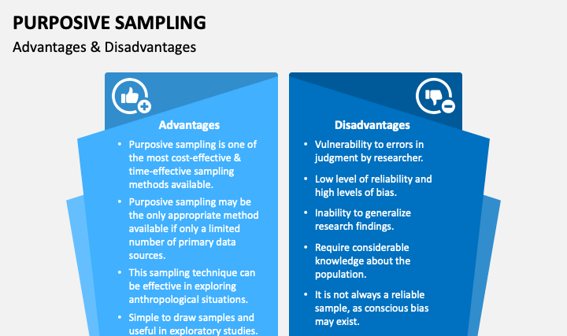
Sketchbubble.com

Slide 16
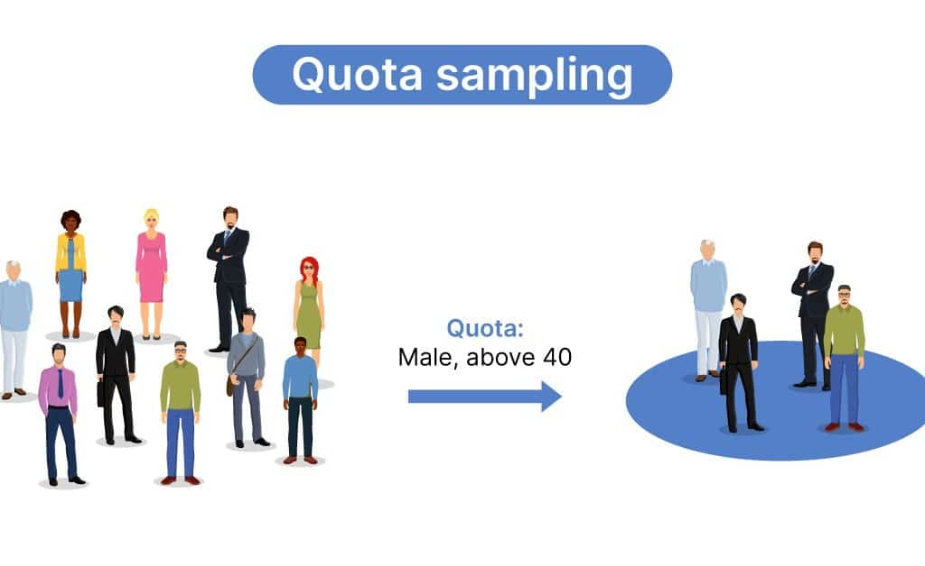
Quota sampling
The population is divided into mutually exclusive sub-groups
The sub-groups are selected according to known criteria
E.g. 60% female students and 40% male students in a UoT of 100 000 students. The sample of 300 must represent this demographic i.e. 180 female and 120 male.
Voxco.com

Slide 17
Advantages
Disadvantages
Primary data collection can be done in a shorter time
Relatively cost-effective and requires less resources
Difficult to calculate the sampling error and generalization of findings to the population is not accurate.
Other characteristics may be disproportionately represented in the final sample group
Researcher bias
Possibility of poor quality researcher incompetency lack of experience in quota sampling

Slide 18
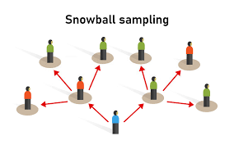
Snowball sampling
When there are very few participants that fit the required characteristics
When one expert is found that expert can recommend others
Also known as chain sampling, chain-referral sampling, and referral sampling
Formpl.us

Slide 19
Advantages
Disadvantages
Quick to find reliable participants as they come from reliable sources. An additional task is saved for a researcher, this time can be used for other research activities.
Cost effective as the referrals are obtained from a primary data source. It’s is convenient and not so expensive as compared to other methods.
Some people do not want to participate in research because they don’t want to expose their identity. Snowball sampling helps as they are asked by a known person. Therefore, sense of trust.
Since people are referring to each other, there is a potential for sampling bias and margin of error.
There is the possibility that even after referrals from trusted people, some might not be cooperative and refuse to participate in the research.

Slide 20

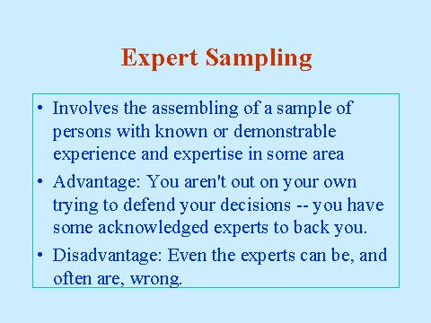
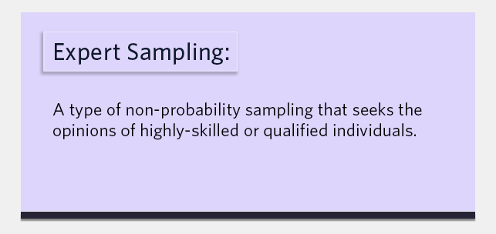
Expert sampling
Similar to purposive sampling
Difference is that the “experts” are able to alter the research
  They are change agents not simply sources of data
  E.g. expert researchers in the area of Health Information Systems
Ruby.fgcu.edu
sogosurvey

Slide 21
Please read the lecture note for this section.
Available on Moodle.
Questions and comments are welcome: alveens@dut.ac.za

